Slide 1

Big Data Computing 20-21
Musical Genres Recognition with Spotify Audio Features
Antonio D’Orazio – Id. 1967788

Slide 2
The project
The goal of the project is to build a model to classify musical tracks into their genres, according to their Spotify audio features
A clustering phase will be used to «build» the labels which represent different genres
A little demo is included in the notebook
It queries a song from Spotify, it builds a dataframe and then it passes it to the final model for the prediction.

Slide 3
The datasets
Spotify Artists Dataset: each artist contain a list of genres
Spotify Genres Dataset: contains the value of the features associated to a specific musical genre
Spotify Tracks Dataset: contains a list of tracks for each country
I’m using the file tracks.csv, which contains already the union of the csv organized by countries, without duplicates

Slide 4
The audio features
Acousticness [0.0 to 1.0]: a measure of whether the track is acoustic
Danceability [0.0 to 1.0]: how much a track is suitable for dancing
Energy [0.0 to 1.0]: the intensity of the song. An energetic track is fast, loud, and noisy.
Instrumentalness [0.0 to 1.0]: whether a track contains no vocals
Liveness [0.0 to 1.0]: the more the value, the higher the probability that the track was performed live
Loudness [~-60db to 0db]: the overall volume of the track
Key: the musical key of the track
Speechiness [0.0 to 1.0]: higher if the tracks has speech-like vocals (e.g., rap)
Valence [0.0 to 1.0]: if higher, the tracks sound more positive and euphoric

Slide 5
Data preprocessing
Tracks:
Remove rows with null values
Remove rows with not in range values
Genres:
Text preprocessing on the genres
Normalization, trimming, punctuation filtering, …
Remove unnecessary words
Geographical information
(e.g. german folk, irish folk -> folk)
With NLP and a regex
Unfrequent genres

Slide 6
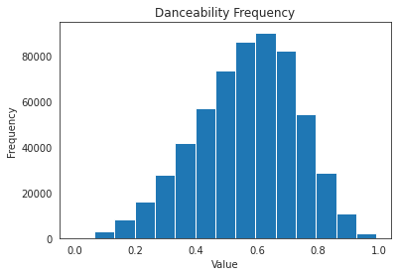
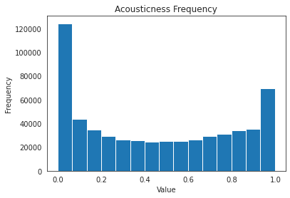
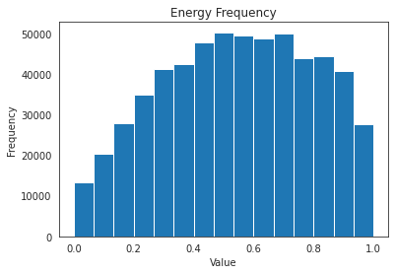
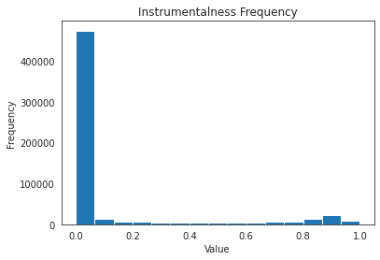
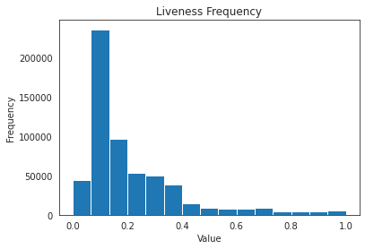
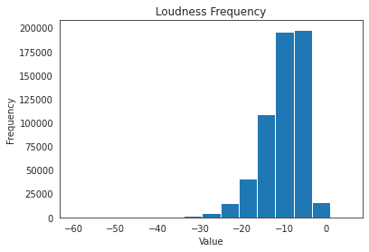
Distribution of the features in the tracks

Slide 7
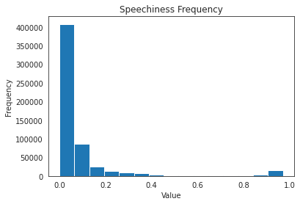
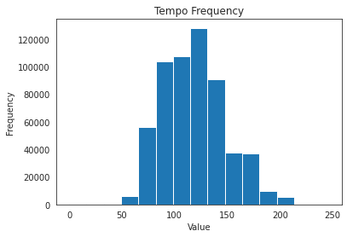
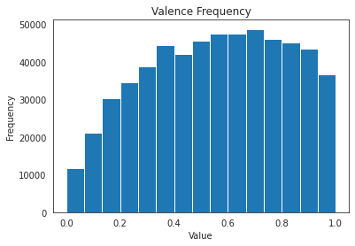
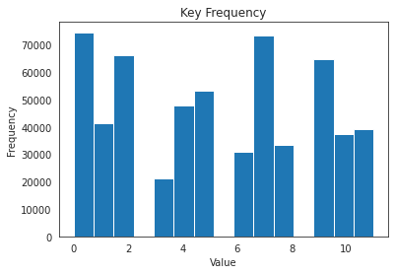
Distribution of the features in the tracks

Slide 8
Approach 1: no clustering

Slide 9
Additional preprocessing
Need to assign genres to the tracks
Join the tracks with their respective artists
Split each record in multiple rows by artists and genres
To assign a single genre: select the label with less distance between the track and the features descripted in the genres dataset.
Feature selection to simplify the training phase (see later in the slides)

Slide 10
Poor performance!
Long training time
Need to select a subset of the whole dataset
Very low score
The logistic regression fails at handling all the labels
The random forest performs better, but overfits

Slide 11
Summary
Logistic Regression
Training set
Accuracy: 0.144
Weighted Precision: 0.108
Weighted Recall: 0.144
Test set
Weighted Precision: 0.018
Weighted Recall: 0.109
Accuracy: 0.109
Random Forest
Training set
Accuracy: 1.0
Weighted Precision: 1.0
Weighted Recall: 1.0
Test set
Accuracy: 0.118
Weighted Precision: 0.050
Weighted Recall: 0.118
Overfitting

Slide 12
Approach 2: with clustering

Slide 13
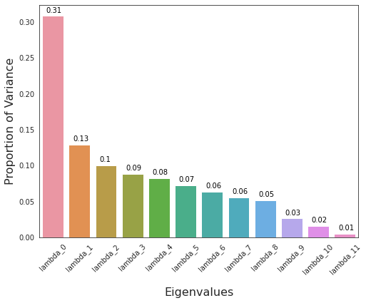
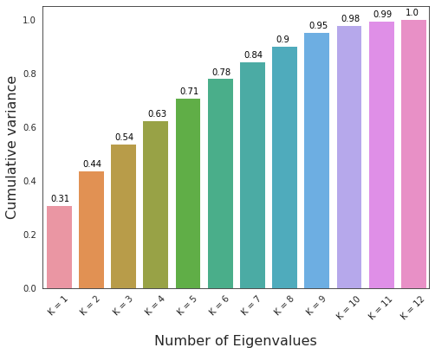
Before clustering: PCA Analysis
How many features should we use for the clustering phase?
PCA results (with std dataset). Choose pca_k such that there is at least 40% to 60% of the variance
Lamba_0 explains a lot of variance already

Slide 14
Clustering: K-Means algorithm
Hyperparameters: find the best pca_k for the PCA analysis, find the best k for clusters
Pipeline
Assemble the features with a VectorAssembler
Scale the dataset with mean and std
Perform a PCA Analysis
Perform the K-Means algorithm

Slide 15
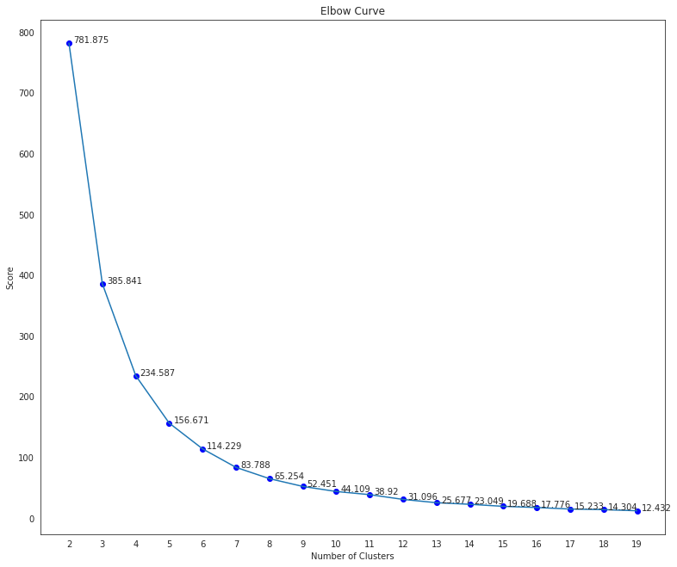
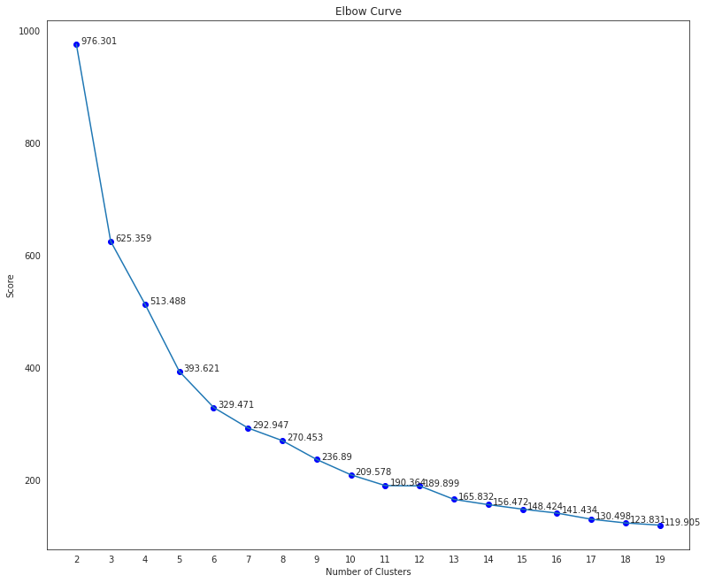
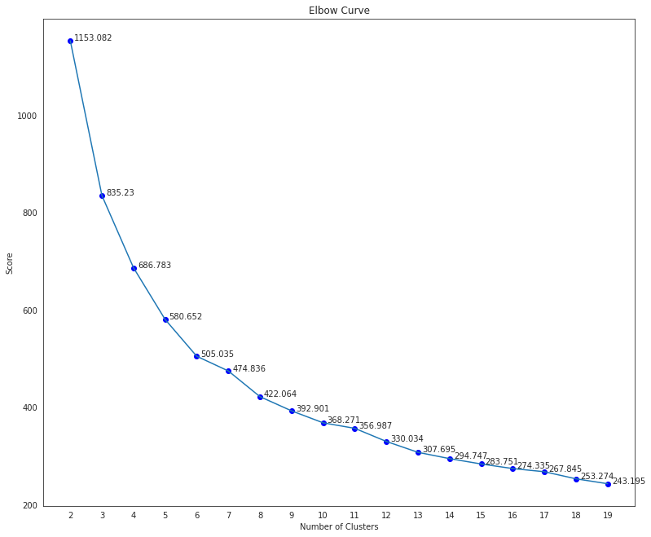
K-Means: evaluation
Elbow curves for pca_k = 2, 3, 4

Slide 16
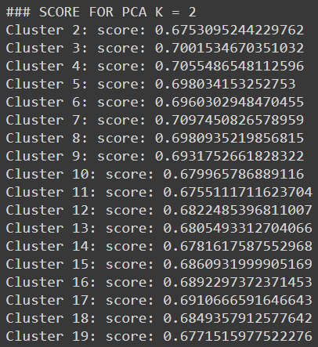
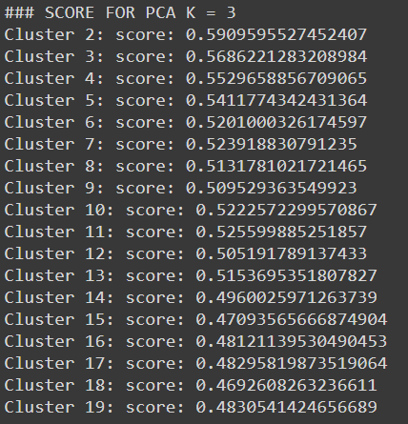
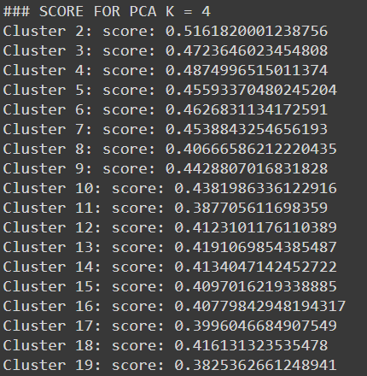
K-Means: silhouette score

Slide 17
K-Means evaluation: summary
The best scores are with PCA_k = 2
The elbow curve suggests that the number k of clusters should be in [5, 6, 7]
With PCA_k = 2 and K = 7, the Silhouette coefficient is high
By exploring the clusters I found k = 7 to be a good compromise:
Cluster 0: Metal/Hardstyle
Cluster 1: Experimental/Progressive
Cluster 2: Classic/Piano/Jazz
Cluster 3: Rock/Punk/Indie
Cluster 4: Blues/Soul
Cluster 5: Hip hop/Rap
Cluster 6: Folk/Songwriting

Slide 18
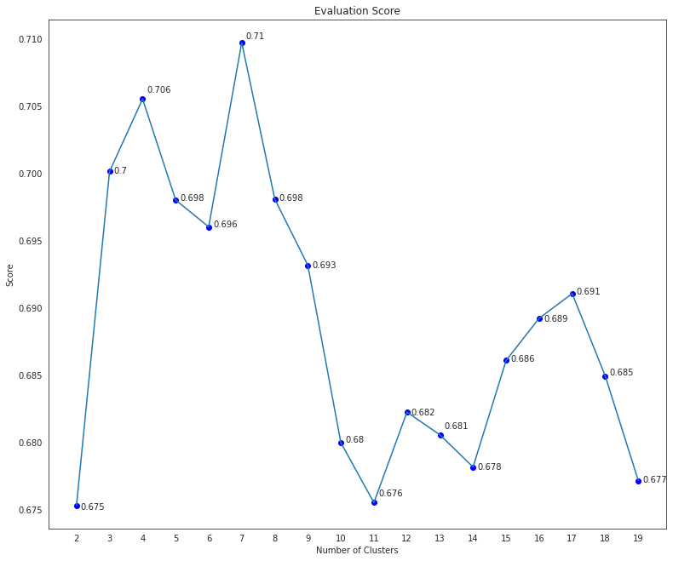
K-Means evaluation: summary
Plotting of the Silhouette score
for PCA_k = 2

Slide 19
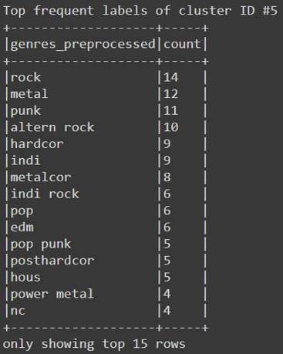
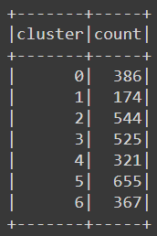
K-Means evaluation: summary
Example of a cluster
Total count for each cluster

Slide 20
Model training: LR and RF
Approaches used:
Multinomial Logistic Regression with features selection
Random Forest with all the features
Both are done with standardization, k-fold cross validation for hyperparameter tuning
Evaluation metric for cross validator: F1 score
To focus on both weighted precision and weighted recall

Slide 21
Feature selection
Find the correlation between each feature and the target label
Filter out the unnecessary features
Find the correlation between each pair of the remaining featues
Filter out one label of the pair, if they’re too correlated (if any)
Usually, the one which less correlates with the label

Slide 22
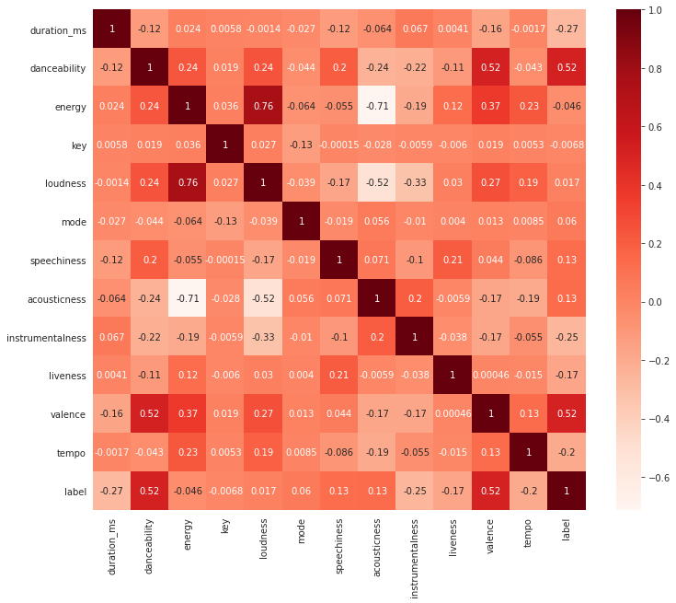
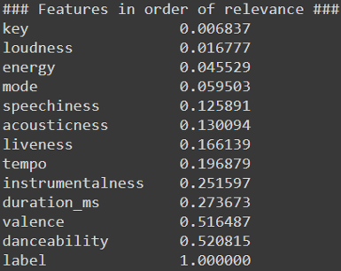
Feature selection
LR_FEATURES =
"danceability", "duration_ms",
"tempo", "liveness"

Slide 23
Logistic Regression: results
K-Fold validation: best f1 score
Average f1 score: 0.471
Training set
Accuracy: 0.480
Weighted Precision: 0.482
Weighted Recall: 0.480
Precision by Label: [0.46, 0.57, 0.53, 0.43, 0.52, 0.48, 0.42]
Recall by Label: [0.36, 0.16, 0.64, 0.49, 0.47, 0.57, 0.38]
Test set
Weighted Precision: 0.483
Weighted Recall: 0.480
Accuracy: 0.480

Slide 24
Random Forest: Results
K-Fold validation: best f1 score
Average f1 score: 0.749
Training set
Accuracy: 0.784
Weighted Precision: 0.784
Weighted Recall: 0.784
Precision by Label: [0.81, 0.80, 0.83, 0.77, 0.76, 0.77, 0.78]
Recall by Label: [0.84, 0.48, 0.88, 0.79, 0.77, 0.75, 0.84]
Test set
Accuracy: 0.753
Weighted Precision: 0.752
Weighted Recall: 0.753

Slide 25
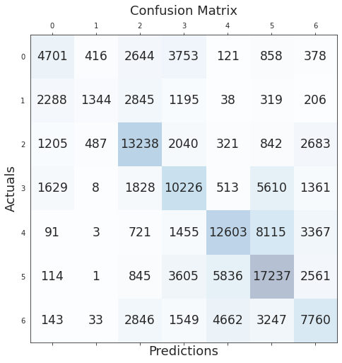
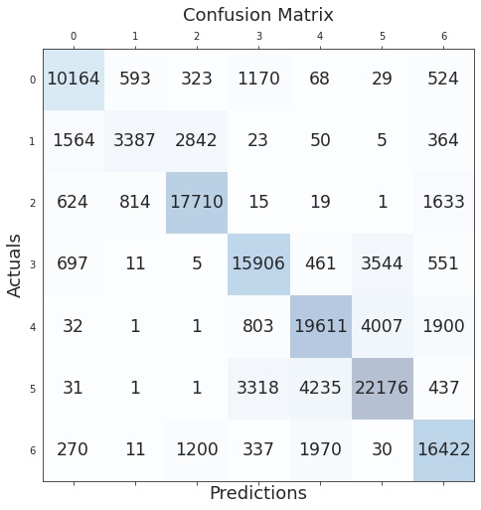
Logistic Regression vs Random Forest

Slide 26
Summary
Random forest performs way better than the logistic regression
Best parameters according to K-Fold cross validation:
LR: lambda: 0.0, alpha: 0.0
RF: numTrees: 12 , maxDepth: 120 or 140 (same score)

Slide 27
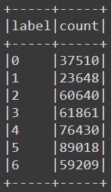
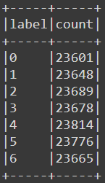
One last improvement
Undersampling to reduce the data imbalance
Take the least occurring label as the base
Compute the rate with each remaining label
Subselect randomly some rows according to the rate
Before and after the undersampling

Slide 28
The final model: Results
Training set
Accuracy: 0.892
Weighted Precision: 0.893
Weighted Recall: 0.892
Precision by Label: [0.90, 0.86, 0.94, 0.89, 0.88, 0.89, 0.88]
Recall by Label: [0.91, 0.93, 0.86, 0.88, 0.89, 0.85, 0.92]
Test set
Accuracy: 0.832
Weighted Precision: 0.839
Weighted Recall: 0.832

Slide 29
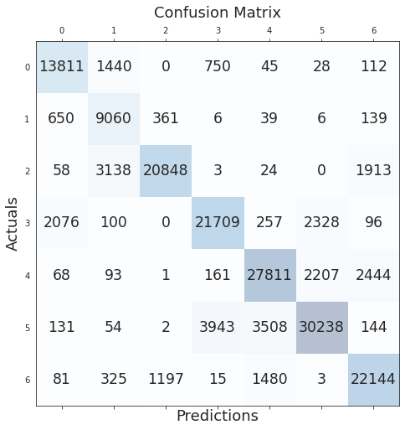
The final model: confusion matrix

Slide 30
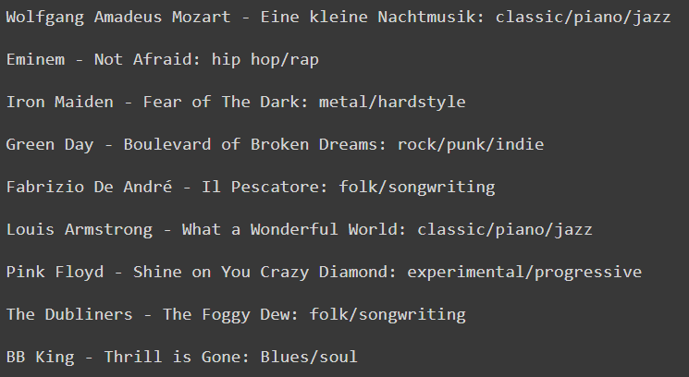
Some predictions

Slide 31
Sources
The notebooks of the course were used as a base to build my project
For matplotlib/seaborn references: many articles on the internet, stackoverflow, etc.
For class signatures and explanations: official PySpark documentation

